Slide 1
State Farm Distracted Driver Detection

Slide 2
Steps
Imports and Setups
Data Exploration and Preparation
Model Development
Data Augmentation
Transfer Learning
CNN Visualization

Slide 3
Imports and Setups
We downloaded kaggle data in Google Colab using Kaggle’s public API.
Extracted data from the zipped file.
Imported the necessary libraries.

Slide 4
Data Exploration and Preparation
we read data and checked samples of images.
we used "value_counts()" to check if the data is balanced or not.
We Draw some sample of images.
We spitted the data to train and validation [80,20], then preprocessing the images using :
Normalizing the data by dividing on 255.
Reshaping every image to be (64 * 64 * 3) instead of (64, 64, 3).

Slide 5
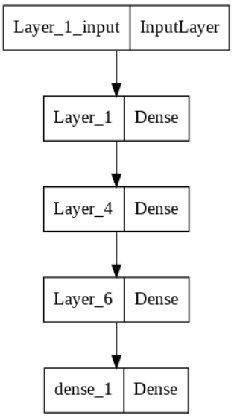
Model Development Baseline Dense layers model
We used optimizer='Adam', loss='categorical_crossentropy', metrics=['accuracy'] for this model to compile the model.
Build the dense layers model with hierarchy of output features of (128, 64, 32, 10) and "relu" activation function in every dense layer except the last one "The output layer" which will be "softmax".

Slide 6
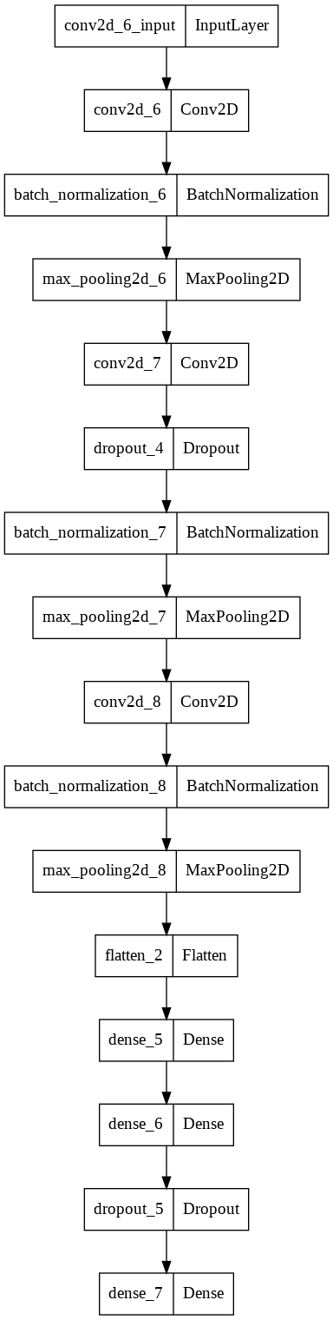
Model Development Baseline CNN model
Now, we will use CNN model and we will add :
BatchNormalization for normalization
MaxPool2D with (2,2) Kernel
Dropout with percentage of 20%
The input shape here will be (64,64,3) as CNN accept RGB 3 channels.
We will use the same model compilation setting optimizer='RMSProp', loss='categorical_crossentropy', metrics=['accuracy'].

Slide 7
Data Augmentation
With data augmentation we tried to create and add more data that will be new for the model based on our original data, The augmentation operations the will be selected randomly are :
zoom_range=0.2,
shear_range = 0.2,
horizontal_flip=True,
fill_mode='nearest',
validation_split = 0.2
We will use the same CNN model with data augmented this time .
Compilation settings are :
optimizer= 'Adam'
loss="categorical_crossentropy"
metrics=["accuracy"]

Slide 8
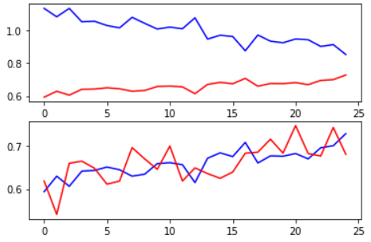
Transfer Learning
We will use VGG16 "ImageNet" pretrained model with the augmented data in our task with a new dense layer at the end instead of the original dense layer of VGG16, parameters are :
weights='imagenet'
input_shape=(64, 64, 3)
include_top=False
First we will use the model without parameter tuning of its original layers so we will make model.trainable = False, Here the new dense layer of be trained and will improve it's weights parameters.
We plotted the loss (vs) categorical_accuracy and we got the first graph.
Then plotted categorical_accuracy (vs) val_categorical_accuracy and we got the second one.

Slide 9
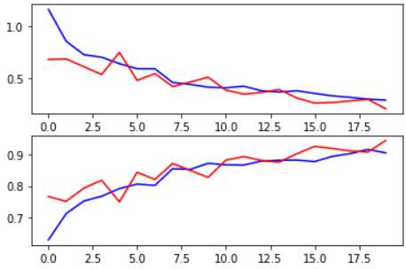
Transfer Learning
First we will use the model without parameter tuning of its original layers so we will make model.trainable = True, Here the all model layers will be trained and will improve its weights parameters but we will not specify specific layers for trainging, we will use a very small learning.
learning_rate = .00001
Loss = CategoricalCrossentropy
Metrics = CategoricalAccuracy
We plotted the loss (vs) val_loss and we got the first graph
Then plotted categorical_accuracy (vs) val_categorical_accuracy and we got the second one

Slide 10
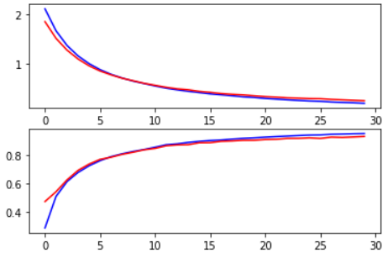
Transfer Learning Transfer Learning Without Augmentation
While using the VGG16 with the original data not the augmented data and model.trainable = false we got more smooth graphs
We plotted the loss (vs) val_loss and we got the first graph
Then plotted categorical_accuracy (vs) val_categorical_accuracy and we got the second one
With compilation parameters :
loss='categorical_crossentropy'
optimizer='Adam'
metrics=['accuracy']

Slide 11
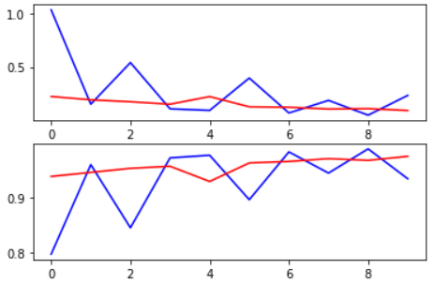
Transfer Learning Transfer Learning Without Augmentation
With model.trainable = true and learning_rate = 0.00001, we got graphs with a different behaviour :
We plotted the loss (vs) val_loss and we got the first graph
Then plotted categorical_accuracy (vs) val_categorical_accuracy and we got the second one
With compilation parameters :
loss='categorical_crossentropy'
optimizer='Adam'
metrics=['accuracy']

Slide 12
CNN Visualization Visualizing intermediate activations
We created a Keras model that takes batches of images as input, and outputs the activations of all convolution and pooling layers.
We chose to Extract the outputs of the top 8 layers.
We chose an image to be fed as input to the model.it then returns the values of the layer activations in the original model.
We visualized the activation of the first convolution layer for our input image.
Then we plotted a complete visualization of all the activations in the network as we extracted and plotted every channel in each of our 8 activation maps, and we will stack the results in one big image tensor, with channels stacked side by side.

Slide 13
CNN Visualization Visualizing the convnet filters
This is applied using gradient ascent in input space.
We used the gradients function packaged with the backend module of Keras.
We put them together into a Python function that takes as input a layer name and a filter index, and that returns a valid image tensor representing the pattern that maximizes the activation the specified filter.
For simplicity, we will only look at the first 64 filters in each layer, and will only look at the first layer of each convolution block (block1_conv1, block2_conv1, block3_conv1, block4_conv1, block5_conv1). We will arrange the outputs on a 8x8 grid of 64x64 filter patterns, with some black margins between each filter pattern.

